Slide 1
Distributed Systems
Middleware
Prof. Nalini Venkatasubramanian
Dept. of Information & Computer Science
University of California, Irvine

Slide 2
CS 237 - Distributed Systems Middleware – Spring 2014
Lecture 1 - Introduction to Distributed Systems Middleware
Mondays,Wednesdays 3:30-4:50p.m.
Prof. Nalini Venkatasubramanian
nalini@ics.uci.edu
Intro to Distributed Systems Middleware

Slide 3
Course logistics and details
Course Web page -
  http://www.ics.uci.edu/~cs237
Lectures – MW 3:30 – 4:50 p.m
Reading List
    Technical papers and reports
    Reference Books
Intro to Distributed Systems Middleware

Slide 4
Course logistics and details
Homeworks
  Paper summaries
  Survey paper
Course Presentation
Course Project
  Maybe done individually or in groups
  Potential projects will be available on webpage
Intro to Distributed Systems Middleware

Slide 5
CompSci 237 Grading Policy
Homeworks - 30%
      1 paper summary due every week
      (3 randomly selected each worth 10% of the final grade).
Survey Paper - 10%
Class Presentation - 10%
Class Project - 50% of the final grade
Final assignment of grades will be based on a curve.
Intro to Distributed Systems Middleware

Slide 6
Lecture Schedule
  Weeks 1,2,3: Distributed Computing Fundamentals
      Middleware Concepts
      Distributed Operating Systems
      Messaging, Communication in Distributed Systems
      Naming , Directory Services, Distributed FileSystems
  Weeks 4,5,6,7: Middleware Frameworks
      Distributed Computing Frameworks – DCE, Hadoop
      Object-based Middleware –CORBA, COM, DCOM
      Java Based Technologies – Java RMI, JINI, J2EE, EJB
      Messaging Technologies - XML Based Middleware, Publish/Subscribe
      Service Oriented Architectures - .NET, Web Services, SOAP, REST, Service Gateways
      Database access and integration middleware (ODBC, JDBC, mediators)
      Cloud Computing Platforms and Technologies - Amazon EC2, Amazon S3, Microsoft Azure, Google App Engine
  Weeks 9, 10: Middleware for Target Application Environments
      Real-time and QoS-enabled middleware
      Middleware for Mobile/Wireless networks and applications
      Middleware for Sensor Networks, Pervasive, CyberPhysical Systems
      Middleware for Resilient/Fault tolerant applications
Intro to Distributed Systems Middleware

Slide 7
What is Middleware?
Middleware is the software between the application programs and the operating System/base networking
Integration Fabric that knits together applications, devices, systems software, data
Middleware provides a comprehensive set of higher-level distributed computing capabilities and a set of interfaces to access the capabilities of the system.
Intro to Distributed Systems Middleware

Slide 8












The Evergrowing Alphabet Soup
Distributed
Computing
Environment (DCE)‏
WS-BPEL
WSIL
Java Transaction API (JTA)‏
Orbix
WSDL
LDAP
JNDI
JMS
IOP
IIOP
GIOP
BPEL
BEA Tuxedo®
EAI
Object Request Broker
(ORB)‏
RTCORBA
SOAP
Message Queuing (MSMQ)‏
Distributed Component
Object Model (DCOM)
XQuery
XPath
opalORB
IDL
ZEN
Remote Method
Invocation
(RMI)‏
JINITM
Rendezvous
ORBlite
Encina/9000
Enterprise
JavaBeans
Technology
(EJB)‏
BEA WebLogic®
Remote Procedure Call
(RPC)‏
Extensible Markup Language (XML)‏
Borland® VisiBroker®

Slide 9
Various Middlewares…
CORBA, OMG, CanCORBA, ORBIX, JavaORB, ORBLite, TAO, Zen, RTCORBA, FTCORBA,DCOM, POA,IDL,IOP,IIOP,
ObjectBroker, Visibroker, Orbix, ObjectBus,ESBs
MOM – TIBCO TIB/Rendezvous, BEA MessageQ, Microsoft MSMQ, ActiveWorks
JVM, JINI, RMI, J2EE, EJB,J2ME, JDBC,JTA, JTS,JMS, JNDI,
Enterprise Middleware Technologies -- BEA WebLogic, IBM WebSphere, TivoliBeans
ENCINA, Tuxedo, CICS
XML, XQuery,
SOAP, Web Services, WSDL, BPEL
…..
Intro to Distributed Systems Middleware

Slide 10
More Views of Middleware
Software technologies to help manage complexity and heterogeneity inherent to the development of distributed systems, distributed applications, and information systems
Higher-level programming abstraction for developing distributed applications
Higher than “lower” level abstractions, such as sockets, monitors provided by the operating system
  a socket is a communication end-point from which data can be read or onto which data can be written
From Arno Jacobsen lectures, Univ. of Toronto

Slide 11
Middleware Systems – more views
Aims at reducing the burden of developing distributed applications for the developer
  informally called “plumbing”, i.e., like pipes that connect entities for communication
  often called “glue code”, i.e., it glues independent systems together and makes them work together
Masks the heterogeneity programmers of distributed applications have to deal with
  network & hardware
  operating system & programming language
  different middleware platforms
  location, access, failure, concurrency, mobility, ...
often also referred to as transparency mechanisms
  network transparency, location transparency
From Arno Jacobsen lectures, Univ. of Toronto

Slide 12
Middleware Systems Views
An operating system is “the software that makes the hardware usable”
Similarly, a middleware system makes the distributed system programmable and manageable
Bare computer without OS could be programmed,
  programs could be written in assembly, but higher-level languages are far more productive for this purpose
Distributed application be developed without middleware
  But far more cumbersome
From Arno Jacobsen lectures, Univ. of Toronto

Slide 13
Distributed Systems
Multiple independent computers that appear as one
  Lamport’s Definition
    “ You know you have one when the crash of a computer you have never heard of stops you from getting any work done.”
  “A number of interconnected autonomous computers that provide services to meet the information processing needs of modern enterprises.”
Intro to Distributed Systems Middleware

Slide 14
Examples of Distributed Systems
Banking systems
Communication - email
Distributed information systems
  WWW
  Federated Databases
Manufacturing and process control
Inventory systems
General purpose (university, office automation)
Intro to Distributed Systems Middleware

Slide 15
Characterizing Distributed Systems
Multiple Computers
  each consisting of CPU’s, local memory, stable storage, I/O paths connecting to the environment
Interconnections
  some I/O paths interconnect computers that talk to each other
Shared State
  systems cooperate to maintain shared state
  maintaining global invariants requires correct and coordinated operation of multiple computers.
Intro to Distributed Systems Middleware

Slide 16
Why Distributed Computing?
Inherent distribution
  Bridge customers, suppliers, and companies at different sites.
Speedup - improved performance
Fault tolerance
Resource Sharing
  Exploitation of special hardware
Scalability
Flexibility
Intro to Distributed Systems Middleware

Slide 17
Why are Distributed Systems Hard?
Scale
  numeric, geographic, administrative
Loss of control over parts of the system
Unreliability of message passing
  unreliable communication, insecure communication, costly communication
Failure
  Parts of the system are down or inaccessible
  Independent failure is desirable
Intro to Distributed Systems Middleware

Slide 18
Design goals of a distributed system
Sharing
  HW, SW, services, applications
Openness(extensibility)
  use of standard interfaces, advertise services, microkernels
Concurrency
  compete vs. cooperate
Scalability
  avoids centralization
Fault tolerance/availability
Transparency
  location, migration, replication, failure, concurrency
Intro to Distributed Systems Middleware

Slide 19
END-USER
Personalized Environment
Predictable Response
Location Independence
Platform Independence
Flexibility
Real-Time Access
to information
Scalability
Faster Developmt.
And deployment of
Business Solutions
System Administrator
Code Reusability
Interoperability
Portability
Reduced
Complexity
Increased
Complexity
Lack of Mgmt.
Tools
Changing
Technology
Application Developer
ORGANIZATION
[Khanna94]
Intro to Distributed Systems Middleware

Slide 20
Enterprise Systems:
Perform enterprise activities
Management
and Support
Application Systems:
support enterprise systems
Interoperability
Distributed Computing Platform
Application Support Services (OS,
DB support, Directories, RPC)
Communication Network Services
(Network protocols, Physical devices)
Hardware
Portability
Integration
Network
Management
Intro to Distributed Systems Middleware

Slide 21
Enterprise Systems:
Engineering systems
Business systems
Manufacturing
Office systems
Management
and Support
Application Systems:
Interoperability
User
Interfaces
Processing
programs
Data files &
Databases
Portability
Distributed Computing Platform
Application Support Services
Integration
C/S Support
Dist. Data
Trans. Mgmt.
Distributed
OS
Network
Management
Common Network Services
Network protocols & interconnectivity
OSI
protocols
TCP/IP
Intro to Distributed Systems Middleware

Slide 22
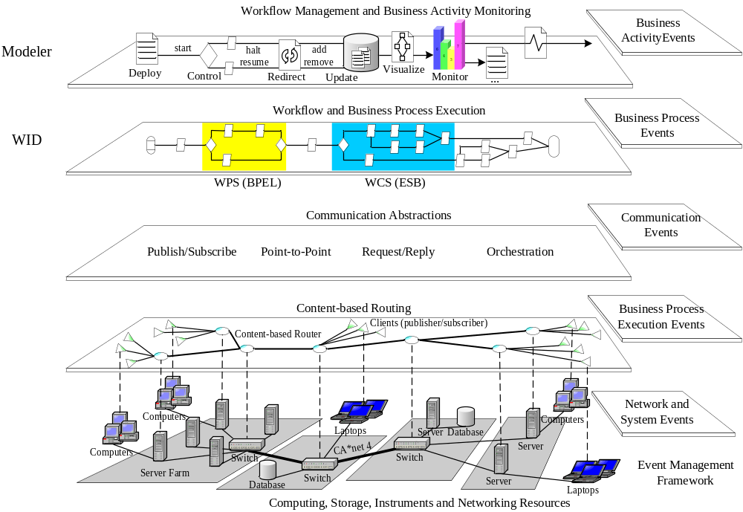
The Enterprise Services Bus
An Event-driven Architecture for a Real-time Enterprise

Slide 23
Distributed Systems & Middleware Research at UC Irvine
Safe and Adaptive Middleware
  CompOSE|Q - Safe composability of m/w services and protocols
    Security, fault tolerance, reliability, QOS, mobility
  Contessa – Context Sensitive System Adaptation (formal methods based)
    Adaptive Data Collection – wireless and instrumented sensor networks
    Adaptive Communication -- groupware on MANETS, mesh networks,
    Adaptive Middleware for Mobile Applications
Mobile Multimedia Systems and Applications
  FORGE – Cross-Layer Adaptation (OS, Device, Network, Application) Techniques
  xTune: On-the-fly formal methods for cross-layer adaptation
  MAPGRID – Grid/Cloud Computing for Mobile Applications
Pervasive Computing Systems and Applications
  Responsphere – A Next Generation Pervasive Computing Testbed
  SATWARE – Stream Acquisition and Transformation Middleware
Application Focused Distributed Systems Research
  RESCUE: Improving Information Flow in Crises
  SAFIRE: Situational Awareness for Firefighters
  Multimedia Applications

Slide 24
Distributed Systems & Middleware Research at UC Irvine
Adaptive and Reflective Middleware:
-- MetaSIM: Reflective Middleware Solutions for Integrated Simulation Environmetns
-- Contessa: Adaptive System Interoperability
-- CompOSE|Q: Composable Open Software Environment with QoS
-- MIRO: Adaptive Middleware for a Mobile Internet Robot Laboratory
-- SIGNAL: Societal Scale Geographical Notification and Alerting
Pervasive and Ubiquitous Computing: _x000b_-- Pervasive Computing for Disaster Response: A Pervasive Computing and Communications Collaboration project between UC Irvine, California Institute of Technology, and IIT Gandhinagar
-- I-sensorium: A shared experimental laboratory housing state-of-the-art sensing, actuation, networking and mobile computing devices
-- SATWARE:A Middleware for Sentient Spaces
-- Quasar:Quality Aware Sensing Architecture
-- SUGA:Middleware Support for Cross-Disability Access
Cyber Physical Systems:
-- Cypress: CYber Physical RESilliance and Sustainability
Middleware Support for Mobile Applications:
-- FORGE: A Framework for Optimization of Distributed Embedded Systems Software
-- Dynamo: Power Aware Middleware for Distributed Mobile Computing
-- MAPGrid: Mobile Applications Powered by Grids
-- Xtune: Cross Layer Tuning of Mobile Embedded Systems
Emergency Response:
-- RESCUE: Responding to Crises and Unexpected Events
-- Customized Dissemination in the Large
-- SAFIRE: Situational Awareness for Firefighters
-- Responsphere: An IT Infrastructure for Responding to the Unexpected
Intro to Distributed Systems Middleware

Slide 25

Research Approach
Design and develop adaptive middleware for distributed applications
When, where, how to adapt
Formal Methods
Foundation
Algorithms
Genetic
Algorithms
Game
Theory
Machine
Learning
Systems
Statistical
Modeling
Design, implementation, evaluation
Graph
Algorithms
Arsenal

Slide 26
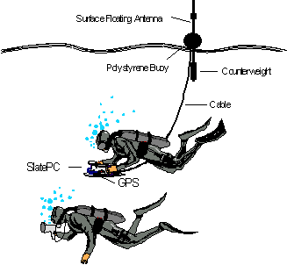


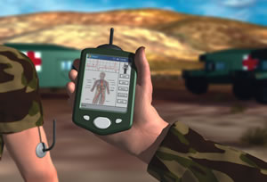
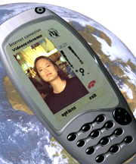
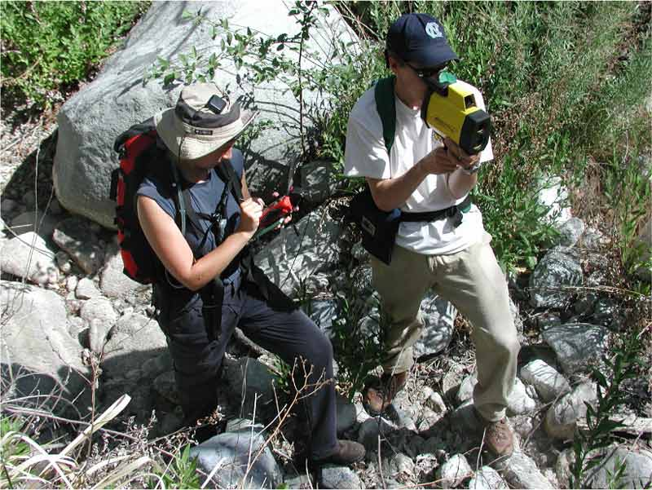
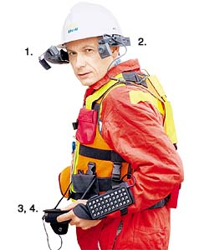

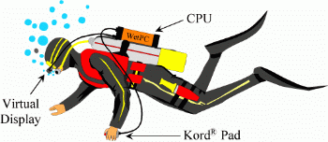
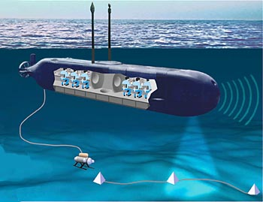
Mobile Middleware

Slide 27
Dynamo: Power Aware Mobile Middleware
To build a power-cognizant distributed middleware framework that can
  exploit global changes (network congestion, system loads, mobility patterns)
  co-ordinate power management strategies at different levels
(application, middleware, OS, architecture)
  maximize the utility (application QoS, power savings) of a low-power device.
  study and evaluate cross layer adaptation techniques for performance vs. quality vs. power tradeoffs for mobile handheld devices.
Network Infrastructure
Caching
Compress
Encryption
Decryption
Compositing
Transcode
Execute Remote Tasks
Low-power
mobile device
Wide Area
Network
Wireless
Network
proxy
Use a Proxy-Based Architecture

Slide 28
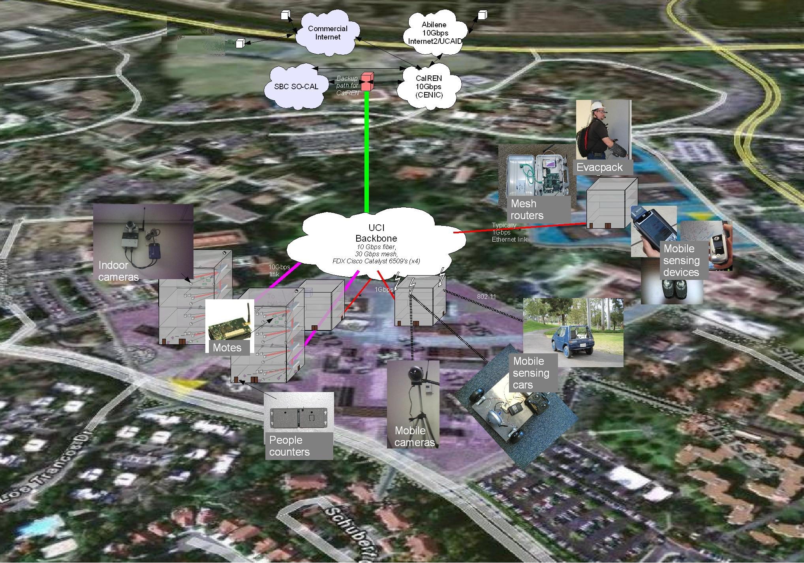

Middleware for Pervasive Systems - UCI I-Sensorium Infrastructure
Campus-wide infrastructure to instrument, experiments, monitor, disaster drills & to validate technologies
sensing, communicating, storage & computing infrastructure
Software for real-time collection, analysis, and processing of sensor information
used to create real time information awareness & post-drill analysis

Slide 29


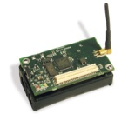
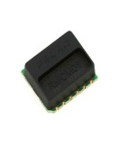
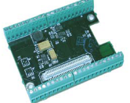
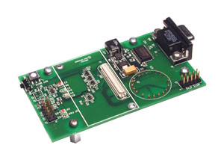
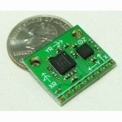
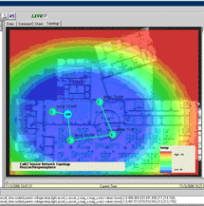

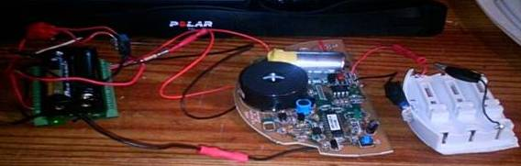


Mote Sensor Deployment
Heart Rate
Proprietary EMF transmission
Polar T31 Heart rate strap transmitter
Polar Heart Rate Module
Crossbow MIB510 Serial Gateway
Inertial positioning
Crossbow MDA 300CA Data Acquisition board on MICAz 2.4Ghz Mote
IMU (5 degrees of freedom)
IEEE 802.15.4 (zigbee)
To SAFIRE Server
Carbon monoxide
Temperature, humidity
Carboxyhaemoglobin, light

Slide 30


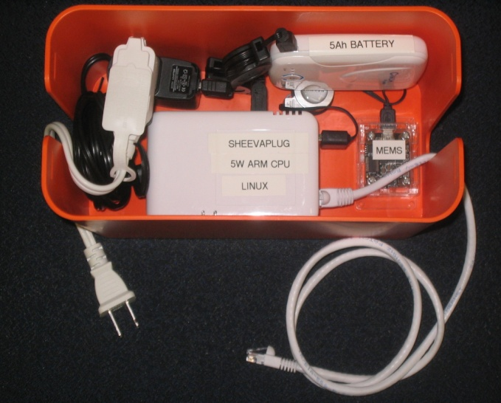
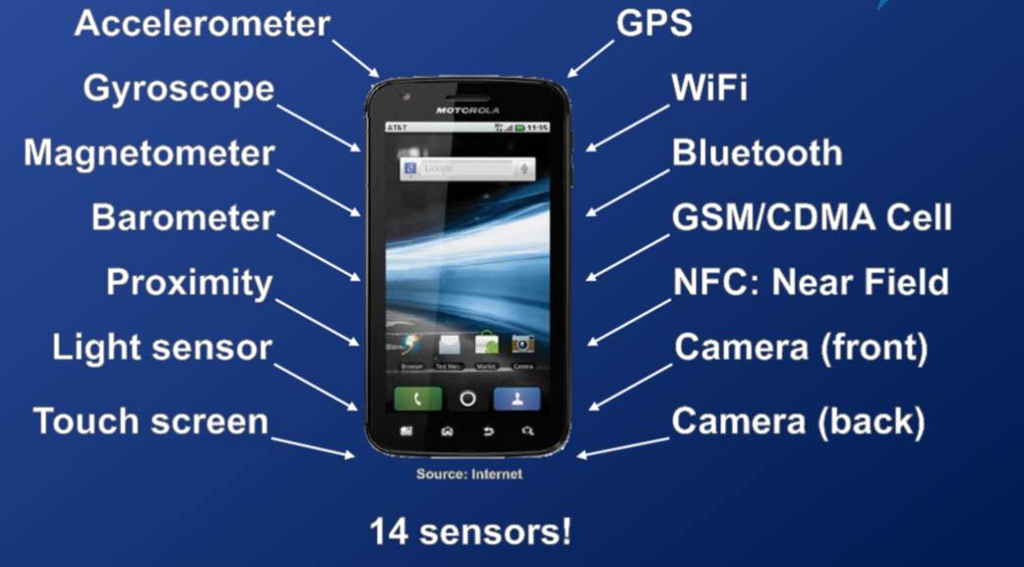
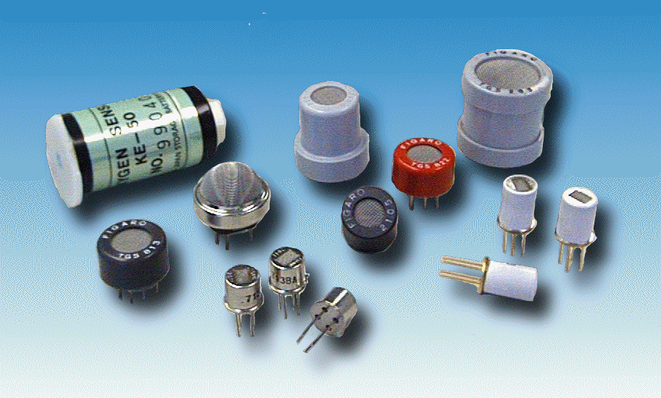
UC Irvine Sensorium Boxes
(building on Caltech CSN project)
Humidity
  control (de)humidifer, particularly for individuals with respiratory ailments
Camera
  boiling pot, monitor pet's food and water, face recognition
Microphone / accelerometer
  detect gunshot in an apartment building / complex
Microphone / light sensor
  monitor thunderstorm activity
SheevaPlug computer
Accelerometer
Ethernet
Battery backup
Additional Sensors
  Wi-Fi dongle, Smoke, Toxic gases (e.g. CO), Radiation, Humidity, Microphone, Camera

Slide 31
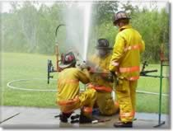
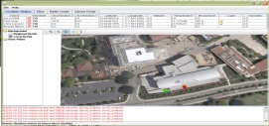


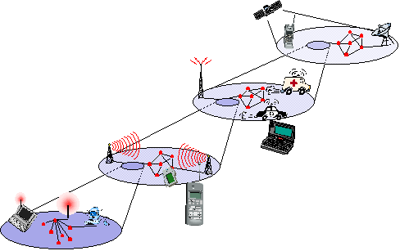
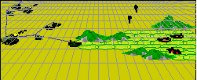

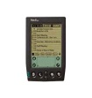








SAFIRENET – Next Generation MultiNetworks
Information need
Multitude of technologies
  WiFi (infrastructure, ad-hoc), WSN, UWB, mesh networks, DTN, zigbee
SAFIRE Data needs
  Timeliness
    immediate medical triage to a FF with significant CO exposure
  Reliability
    accuracy levels needed for CO monitoring
Limitations
  Resource Constraints
    Video, imagery
    Transmission Power, Coverage,
  Failures and Unpredictability
Goal
  Reliable delivery of data over unpredictable infrastructure
DATA
NEEDS
Multiple networks
Sensors
Dead Reckoning
(don’t send
Irrelevant data)

Slide 32
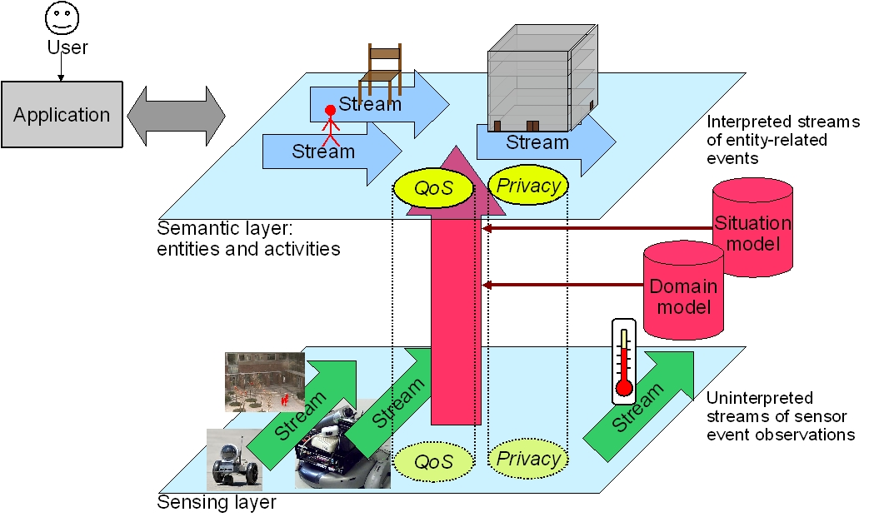
SATware: A semantic middleware for multisensor applications
Abstraction
- makes programming easy
- hides heterogeneity, failures, concurrency
Provides core services across sensors
- alerts, triggers, storage, queries
Mediates app needs and resource constraints
- networking, computation, device

Slide 33
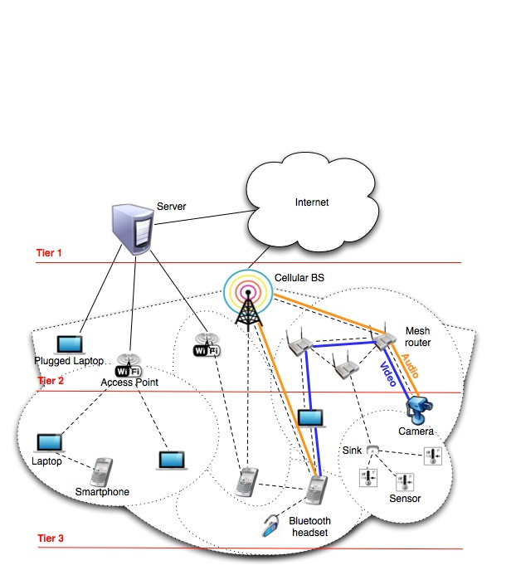
MINA: A Multinetwork Information Architecture
1. Tier based overlay architecture
(Using Network centrality, clustering )
Observe-Analyze-Adapt
2. Heterogeneous Networks and devices
3. Diverse services and applications
Notes:
Observe: Data collection in dynamic mobile environment
Formal based what if analysis
QoS based flow scheduling/Human in the loop

Slide 34
Next Generation Alerting Systems
Dissemination
in
the Large
Delivery Layer
Research
Content Layer
Research
Systems and
Deployments
Wired
Networks
Wireless
Networks
Efficient
Publish
Subscribe
Content
Customization
CrisisAlert
DisasterPortal

Slide 35

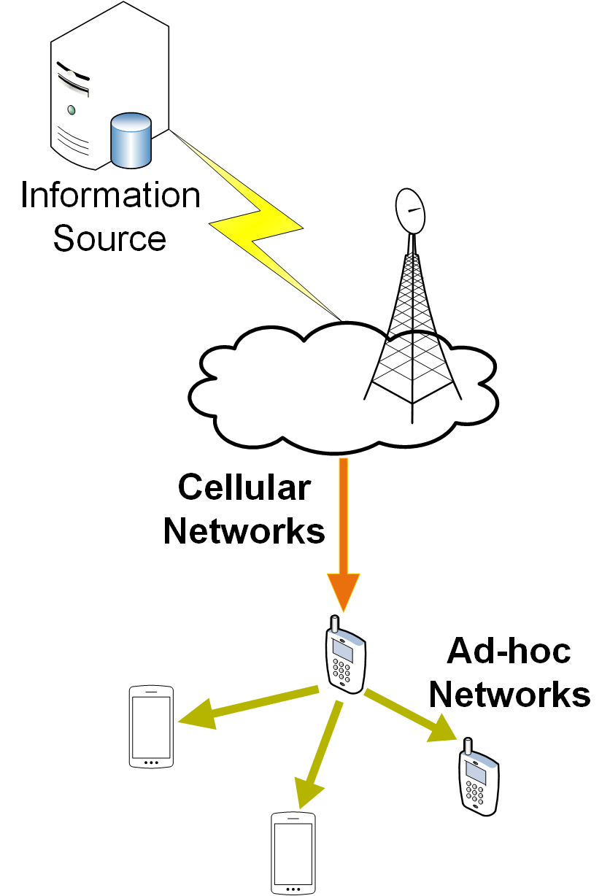







Content Delivery with
Hybrid Networks
Content Delivery
Non-Cooperative
Cooperative
Cost-Driven Content Delivery
Delay- Guaranteed Content Delivery
Reliable and Fast Content Delivery
Massive Video Streaming
Infrastructure Networks

Slide 36




Societal Scale Information Sharing
Societal scale instant information sharing
Societal scale delay-tolerant information sharing
DYNATOPS: efficient Pub/Sub under societal scale dynamic information needs
efficient mobile information crowdsoursing and querying
Information Layer
DEBS’13
In progress
Dissemination Layer
GSFord: Reliable information delivery under regional failures
OFacebook: efficient offline access to online social media on mobile devices
SRDS’12
(MIDDLEWARE’13, INFOCOM’14)

Slide 37
Classifying Distributed Systems
Based on degree of synchrony
  Synchronous
  Asynchronous
Based on communication medium
  Message Passing
  Shared Memory
Fault model
  Crash failures
  Byzantine failures
Intro to Distributed Systems Middleware

Slide 38
Computation in distributed systems
Asynchronous system
  no assumptions about process execution speeds and message delivery delays
Synchronous system
  make assumptions about relative speeds of processes and delays associated with communication channels
  constrains implementation of processes and communication
Models of concurrency
  Communicating processes
  Functions, Logical clauses
  Passive Objects
  Active objects, Agents
Intro to Distributed Systems Middleware

Slide 39
Concurrency issues
Consider the requirements of transaction based systems
  Atomicity - either all effects take place or none
  Consistency - correctness of data
  Isolated - as if there were one serial database
  Durable - effects are not lost
General correctness of distributed computation
  Safety
  Liveness
Intro to Distributed Systems Middleware

Slide 40
Flynn’s Taxonomy for Parallel Computing
Instructions
Single (SI)
Multiple (MI)
Single (SD)
SISD Single-threaded process | MISD Pipeline architecture
SIMD Vector Processing | MIMD Multi-threaded Programming
Data
Multiple (MD)
Parallelism – A Practical Realization of Concurrency

Slide 41
SISD (Single Instruction Single Data Stream)
Processor
D
D
D
D
D
D
D
Instructions
A sequential computer which exploits no parallelism in either the
instruction or data streams.
Examples of SISD architecture are the traditional uniprocessor machines
(currently manufactured PCs have multiple processors) or old mainframes.

Slide 42
SIMD
Processor
D₀
D₀
D₀
D₀
D₀
D₀
D₀
D₁
D₁
D₁
D₁
D₁
D₁
D₁
D₂
D₂
D₂
D₂
D₂
D₂
D₂
D₃
D₃
D₃
D₃
D₃
D₃
D₃
D₄
D₄
D₄
D₄
D₄
D₄
D₄
…
…
…
…
…
…
…
D_{n}
D_{n}
D_{n}
D_{n}
D_{n}
D_{n}
D_{n}
Instructions
A computer which exploits multiple data streams against a single instruction
stream to perform operations which may be naturally parallelized.
For example, an array processor or GPU.

Slide 43
MISD (Multiple Instruction Single Data)
D
Instructions
D
Instructions
Multiple instructions operate on a single data stream.
Uncommon architecture which is generally used for fault tolerance.
Heterogeneous systems operate on the same data stream and
aim to agree on the result.
Examples include the Space Shuttle flight control computer.
Intro to Distributed Systems Middleware

Slide 44
MIMD
Processor
D
D
D
D
D
D
D
Instructions
Processor
D
D
D
D
D
D
D
Instructions
Multiple autonomous processors simultaneously executing different instructions on different data.
Distributed systems are generally recognized to be MIMD architectures;
either exploiting a single shared memory space or a distributed memory space.

Slide 45
Communication in Distributed Systems
Provide support for entities to communicate among themselves
  Centralized (traditional) OS’s - local communication support
  Distributed systems - communication across machine boundaries (WAN, LAN).
2 paradigms
  Message Passing
    Processes communicate by sharing messages
  Distributed Shared Memory (DSM)
    Communication through a virtual shared memory.
Intro to Distributed Systems Middleware

Slide 46
Message Passing
Basic communication primitives
  Send message
  Receive message
Modes of communication
  Synchronous
    atomic action requiring the participation of the sender and receiver.
    Blocking send: blocks until message is transmitted out of the system send queue
    Blocking receive: blocks until message arrives in receive queue
  Asynchronous
    Non-blocking send:sending process continues after message is sent
    Blocking or non-blocking receive: Blocking receive implemented by timeout or threads. Non-blocking receive proceeds while waiting for message. Message is queued(BUFFERED) upon arrival.
Intro to Distributed Systems Middleware

Slide 47
Reliability issues
Unreliable communication
  Best effort, No ACK’s or retransmissions
  Application programmer designs own reliability mechanism
Reliable communication
  Different degrees of reliability
  Processes have some guarantee that messages will be delivered.
  Reliability mechanisms - ACKs, NACKs.
Intro to Distributed Systems Middleware

Slide 48
Reliability issues
Unreliable communication
  Best effort, No ACK’s or retransmissions
  Application programmer designs own reliability mechanism
Reliable communication
  Different degrees of reliability
  Processes have some guarantee that messages will be delivered.
  Reliability mechanisms - ACKs, NACKs.
Intro to Distributed Systems Middleware

Slide 49
Distributed Shared Memory
Abstraction used for processes on machines that do not share memory
  Motivated by shared memory multiprocessors that do share memory
Processes read and write from virtual shared memory.
  Primitives - read and write
  OS ensures that all processes see all updates
Caching on local node for efficiency
  Issue - cache consistency
Intro to Distributed Systems Middleware

Slide 50
Remote Procedure Call
Builds on message passing
  extend traditional procedure call to perform transfer of control and data across network
  Easy to use - fits well with the client/server model.
  Helps programmer focus on the application instead of the communication protocol.
  Server is a collection of exported procedures on some shared resource
  Variety of RPC semantics
    “maybe call”
    “at least once call”
    “at most once call”
Intro to Distributed Systems Middleware

Slide 51
Fault Models in Distributed Systems
Crash failures
  A processor experiences a crash failure when it ceases to operate at some point without any warning. Failure may not be detectable by other processors.
    Failstop - processor fails by halting; detectable by other processors.
Byzantine failures
  completely unconstrained failures
  conservative, worst-case assumption for behavior of hardware and software
  covers the possibility of intelligent (human) intrusion.
Intro to Distributed Systems Middleware

Slide 52
Other Fault Models in Distributed Systems
Dealing with message loss
  Crash + Link
    Processor fails by halting. Link fails by losing messages but does not delay, duplicate or corrupt messages.
  Receive Omission
    processor receives only a subset of messages sent to it.
  Send Omission
    processor fails by transmitting only a subset of the messages it actually attempts to send.
  General Omission
    Receive and/or send omission
Intro to Distributed Systems Middleware

Slide 53
Other distributed system issues
Concurrency and Synchronization
Distributed Deadlocks
Time in distributed systems
Naming
Replication
  improve availability and performance
Migration
  of processes and data
Security
  eavesdropping, masquerading, message tampering, replaying
Intro to Distributed Systems Middleware

Slide 54
Traditional Systems - Client/Server Computing
Client/server computing allocates application processing between the client and server processes.
A typical application has three basic components:
  Presentation logic
  Application logic
  Data management logic
Intro to Distributed Systems Middleware

Slide 55
Client/Server Models
There are at least three different models for distributing these functions:
  Presentation logic module running on the client system and the other two modules running on one or more servers.
  Presentation logic and application logic modules running on the client system and the data management logic module running on one or more servers.
  Presentation logic and a part of application logic module running on the client system and the other part(s) of the application logic module and data management module running on one or more servers
Intro to Distributed Systems Middleware

Slide 56
Distributed Systems Middleware
  Enables the modular interconnection of distributed software (typically via services)
    abstract over low level mechanisms used to implement management services.
  Computational Model
    Support separation of concerns and reuse of services
  Customizable, Composable Middleware Frameworks
    Provide for dynamic network and system customizations, dynamic invocation/revocation/installation of services.
    Concurrent execution of multiple distributed systems policies.
Intro to Distributed Systems Middleware
Notes:
CORBA-DCOM - heterogeneous interoperability
Specification and adaptation of QoS properties
Provide for dynamic network and system customizations

Slide 57
Modularity via Middleware Services
Application Program
API
API
API
Middleware
Service 1
Middleware
Service 2
Middleware
Service 3
Intro to Distributed Systems Middleware

Slide 58
Useful Middleware Services
  Naming and Directory Service
  State Capture Service
  Event Service
  Transaction Service
  Fault Detection Service
  Trading Service
  Replication Service
  Migration Service
Intro to Distributed Systems Middleware

Slide 59
Types of Middleware Services
Integrated Sets of Services -- DCE
Domain Specific Integration frameworks
Distributed Object Frameworks
Component services and frameworks
  Provide a specific function to the requestor
  Generally independent of other services
  Presentation, Communication, Control, Information Services, computation services etc.
Web-Service Based Frameworks
Cloud Based Frameworks
Intro to Distributed Systems Middleware

Slide 60
Integrated Sets Middleware
An Integrated set of services consist of a set of services that take significant advantage of each other.
Example: DCE
Intro to Distributed Systems Middleware

Slide 61
Distributed Computing Environment (DCE)
DCE - from the Open Software Foundation (OSF), offers an environment that spans multiple architectures, protocols, and operating systems (supported by major software vendors)
  It provides key distributed technologies, including RPC, a distributed naming service, time synchronization service, a distributed file system, a network security service, and a threads package.
DCE
Security
Service
Applications
DCE Distributed File Service
DCE
Distributed
Time Service
DCE
Directory
Service
Other Basic
Services
Management
DCE Remote Procedure Calls
DCE Threads Services
Operating System Transport Services
Intro to Distributed Systems Middleware

Slide 62
Integration Frameworks Middleware
Integration frameworks are integration environments that are tailored to the needs of a specific application domain.
Examples
  Workgroup framework - for workgroup computing.
  Transaction Processing monitor frameworks
  Network management frameworks
Intro to Distributed Systems Middleware

Slide 63
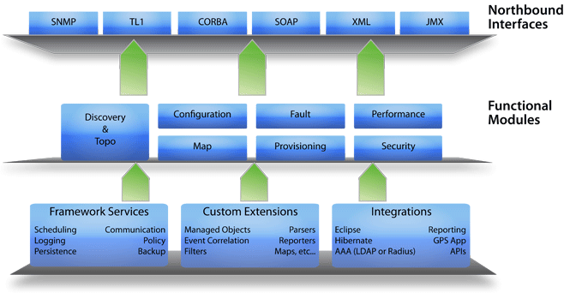
A Sample Network Management Framework (WebNMS)
http://www.webnms.com/webnms/ems.html
Intro to Distributed Systems Middleware

Slide 64
Distributed Object Computing
Combining distributed computing with an object model.
  Allows software reusability
  More abstract level of programming
  The use of a broker like entity or bus that keeps track of processes, provides messaging between processes and other higher level services
  Examples
    CORBA, COM, DCOM
    JINI, EJB, J2EE
    .NET, E-SPEAK
    Note: DCE uses a procedure-oriented distributed systems model, not an object model.
Intro to Distributed Systems Middleware

Slide 65
Distributed Objects
Issues with Distributed Objects
  Abstraction
  Performance
  Latency
  Partial failure
  Synchronization
  Complexity
  …..
Techniques
  Message Passing
    Object knows about network;
    Network data is minimum
  Argument/Return Passing
    Like RPC.
    Network data = args + return result + names
  Serializing and Sending Object
    Actual object code is sent. Might require synchronization.
    Network data = object code + object state + sync info
  Shared Memory
    based on DSM implementation
    Network Data = Data touched + synchronization info
Intro to Distributed Systems Middleware

Slide 66
CORBA
CORBA is a standard specification for developing object-oriented applications.
CORBA was defined by OMG in 1990.
OMG is dedicated to popularizing Object-Oriented standards for integrating applications based on existing standards.
Intro to Distributed Systems Middleware

Slide 67
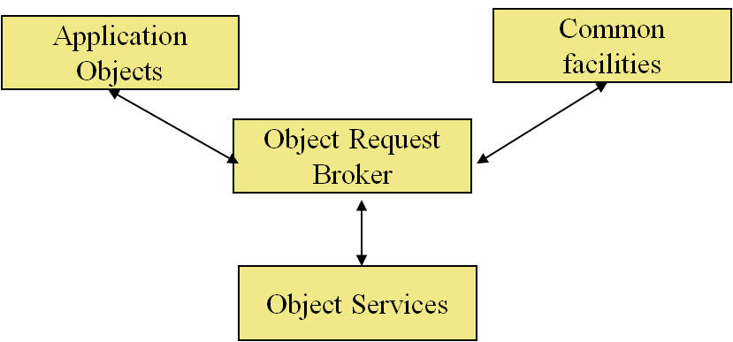
The Object Management Architecture (OMA)
Application objects: document handling objects.
Common facilities: accessing databases, printing files, etc.
ORB: the communication hub for all objects in the system
Object Services: object events, persistent objects, etc.
Intro to Distributed Systems Middleware

Slide 68
Distributed Object Models
Combine techniques
Goal: Merge parallelism and OOP
  Object Oriented Programming
    Encapsulation, modularity
    Separation of concerns
  Concurrency/Parallelism
    Increased efficiency of algorithms
    Use objects as the basis (lends itself well to natural design of algorithms)
  Distribution
    Build network-enabled applications
    Objects on different machines/platforms communicate

Slide 69
Objects and Threads
C++ Model
  Objects and threads are tangentially related
  Non-threaded program has one main thread of control
    Pthreads (POSIX threads)
      Invoke by giving a function pointer to any function in the system
      Threads mostly lack awareness of OOP ideas and environment
      Partially due to the hybrid nature of C++?
Java Model
  Objects and threads are separate entities
    Threads are objects in themselves
    Can be joined together (complex object implements java.lang.Runnable)
      BUT: Properties of connection between object and thread are not well-defined or understood

Slide 70
Java and Concurrency
Java has a passive object model
  Objects, threads separate entities
    Primitive control over interactions
  Synchronization capabilities also primitive
    “Synchronized keyword” guarantees safety but not liveness
    Deadlock is easy to create
    Fair scheduling is not an option

Slide 71
Actors:
A Model of Distributed Objects
Interface
Thread
State
Interface
Procedure
Actor system - collection of independent agents interacting via message passing
State
Messages
Thread
Interface
Procedure
State
Thread
Features
Acquaintances
  initial, created, acquired
History Sensitive
Asynchronous communication
Procedure
An actor can do one of three things:
Create a new actor and initialize its behavior
Send a message to an existing actor
Change its local state or behavior

Slide 72
More middlewares to follow
Web Services and Web Service Frameworks
Enterprise Service Buses
Cloud Computing and Virtualization Platforms
……
Intro to Distributed Systems Middleware

